Slide 1


School of Computing Science and Engineering
Course Code : R1UC406C Course Name: ANN Deep Learning
DNN Models
Name of the Faculty: Dr. Abdul Aleem Program Name: B.Tech

Slide 2
Outline
Recurrent Neural Network (RNN)
Long Short-Term Memory (LSTM)
Gated Recurrent Units (GRU)
Bidirectional RNNs
Bidirectional LSTMs
Name of the Faculty: Dr. Abdul Aleem Program Name: B.Tech

Slide 3
Recurrent Neural Network (RNN)
A recurrent neural network resembles a regular neural network with the addition of a memory state to the neurons.
A simple memory will be included in the computation.
Recurrent neural networks are a form of deep learning method that uses a sequential approach.
We always assume that each input and output in a neural network is reliant on all other levels.
Recurrent neural networks are so named because they perform mathematical computations in consecutive order.
Name of the Faculty: Dr. Abdul Aleem Program Name: B.Tech

Slide 4
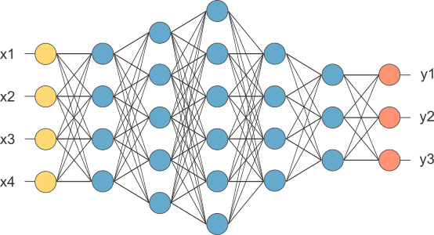
Sample RNN
This is our fully connected network. If x_{1 .}... x_{n}, n is very large and growing, this network would become too large. We now will input one x_{i} at a time and re-use the same edge weights.
Name of the Faculty: Dr. Abdul Aleem Program Name: B.Tech

Slide 5
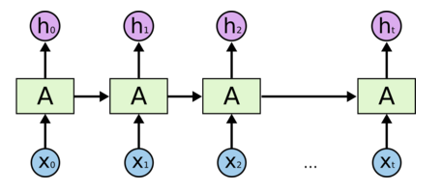
Architecture of RNN
Some information is passed from one subunit to the next
Sequence of outputs
Sequence of inputs
Start of sequence marker
End of sequence marker
Name of the Faculty: Dr. Abdul Aleem Program Name: B.Tech

Slide 6
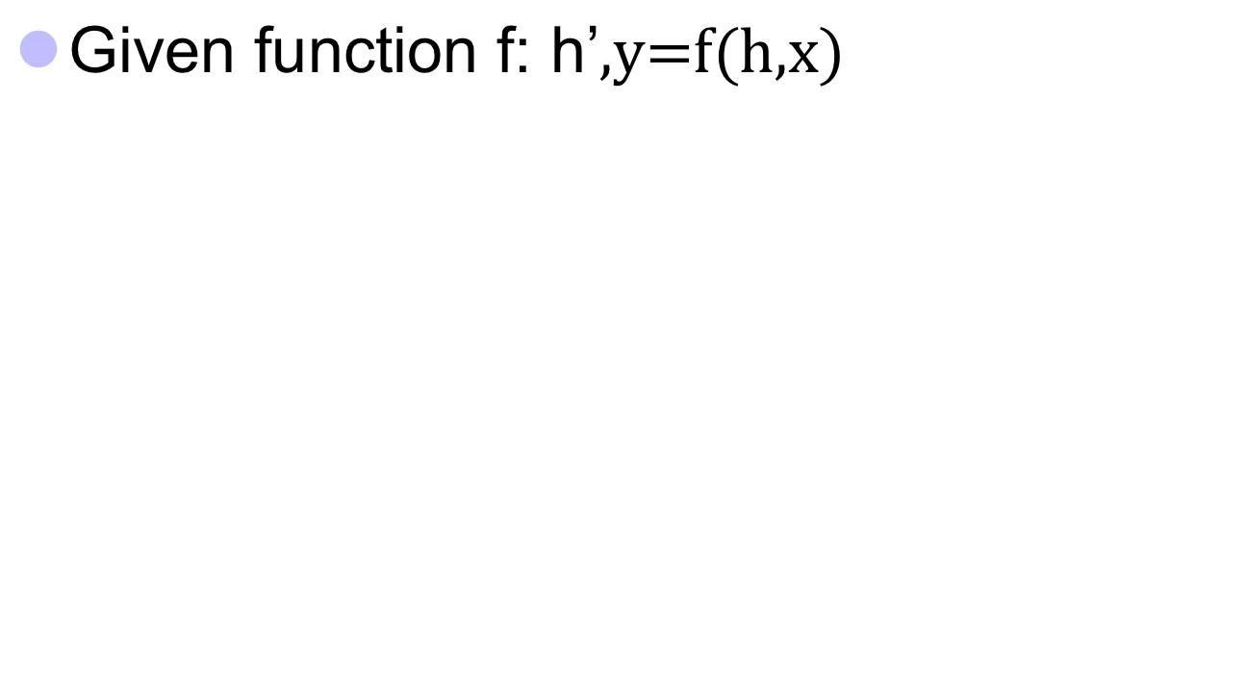



RNN Computation
y
h'
W^{h}
^{h}
W^{i}
x
h
f
h'
y
Wº
^{h’}
Note, y is computed
from h’
x
softmax
We have ignored the bias
Name of the Faculty: Dr. Abdul Aleem Program Name: B.Tech

Slide 7
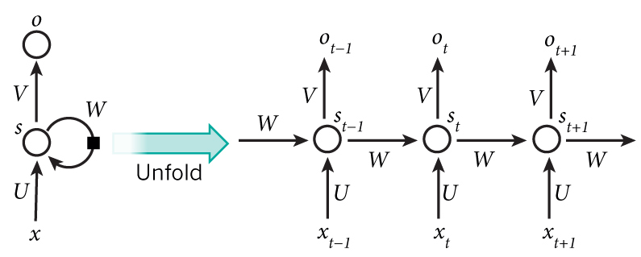

RNN Computation Cont’d …
Name of the Faculty: Dr. Abdul Aleem Program Name: B.Tech

Slide 8
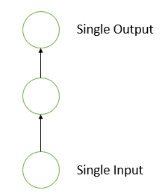
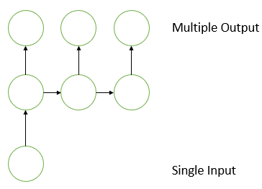
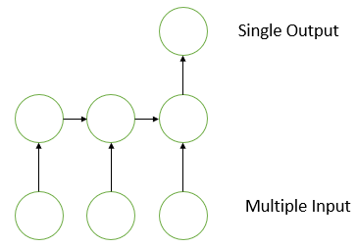
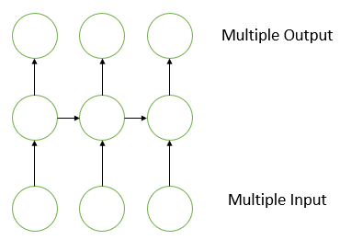
Types of RNN
Types of RNN : One-to-One, One-to-Many, Many-to-One, Many-to-Many
One-to-One
The diagram represents the structure of the Vanilla Neural Network. It is used to solve general machine learning problems that have only one input and output.
Example: classification of images.
One-to-Many
A single input and several outputs describe a one-to-many Recurrent Neural Network. The above diagram is an example of this.
Example: The image is sent into Image Captioning, which generates a sentence of words.
Many-to-One
This RNN creates a single output from the given series of inputs.
Example: Sentiment analysis is one of the examples of this type of network, in which a text is identified as expressing positive or negative feelings.
Many-to-Many
This RNN receives a set of inputs and produces a set of outputs.
Example: Machine Translation, in which the RNN scans any English text and then converts it to French.
Name of the Faculty: Dr. Abdul Aleem Program Name: B.Tech

Slide 9
How does RNN reduce complexity?
Given function f: h’,y=f(h,x)
h and h’ are vectors with the same dimension
y¹
y²
y³
h⁰
f
h¹
f
h²
f
h³
……
x¹
x²
x³
No matter how long the input/output sequence is, we only need one function f. If f’s are different, then it becomes a feedforward NN. This may be treated as another compression from fully connected network.
Name of the Faculty: Dr. Abdul Aleem Program Name: B.Tech

Slide 10
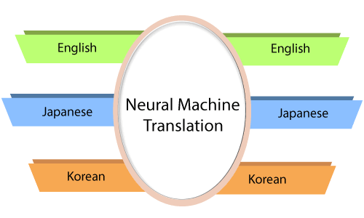
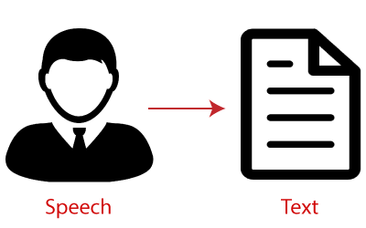
Applications of RNN
Application of RNN:
1. Machine Translation
We make use of Recurrent Neural Networks in the translation engines to translate the text from one to another language.
.
2. Speech Recognition
Recurrent Neural Networks has replaced the traditional speech recognition models that made use of Hidden Markov Models.
These Recurrent Neural Networks, along with LSTMs, are better poised at classifying speeches and converting them into text without loss of context
Name of the Faculty: Dr. Abdul Aleem Program Name: B.Tech

Slide 11
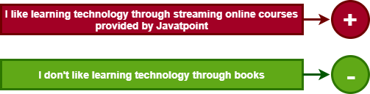
Applications of RNN Cont’d …
3. Sentiment Analysis
We make use of sentiment analysis to positivity, negativity, or the neutrality of the sentence. Therefore, RNNs are most adept at handling data sequentially to find sentiments of the sentence.
Name of the Faculty: Dr. Abdul Aleem Program Name: B.Tech

Slide 12
More About Recurrent Networks
Employ feedback (positive, negative, or both)
a. Not necessarily stable
b. Symmetric connections can ensure stability
Why use recurrent networks?
a. Can learn temporal patterns (time series or oscillations)
b. Biologically realistic
c. Majority of connections to neurons in cerebral cortex are feedback connections from local or distant neurons
Examples
Hopfield network
Boltzmann machine (Hopfield-like net with input & output units)
Recurrent backpropagation networks: for small sequences, unfold network in time dimension and use backpropagation learning
Name of the Faculty: Dr. Abdul Aleem Program Name: B.Tech

Slide 13
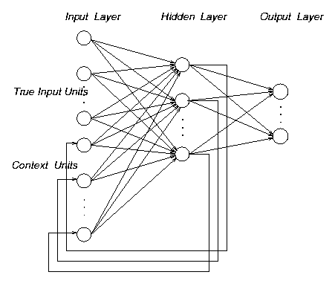
An Example of Recurrent Network
Elman network
Elman networks
Partially recurrent
Context units keep internal memory of part inputs
Fixed context weights
Backpropagation for learning
E.g. Can disambiguate A→B→C and C→B→A
Name of the Faculty: Dr. Abdul Aleem Program Name: B.Tech

Slide 14
Hopfield Networks
Hopfield showed that asynchronous updating in symmetric networks minimizes an “energy” function and leads to a stable final state for a given initial state
Define an energy function (analogous to the gradient descent error function)
E = -1/2 S_{i,j} w_{ij} s_{i} s_{j} + S_{i} s_{i} Θ_{i}
Suppose a random unit i was updated: E always decreases!
If s_{i} is initially –1 and S_{j} w_{ij} s_{j} > Θ_{i}, then s_{i} becomes +1
Change in E = -1/2 S_{j} (w_{ij} s_{j} + w_{ji} s_{j} ) + Θ_{i} = - S_{j} w_{ij} s_{j} + Θ_{i} < 0 !!
If s_{i} is initially +1 and S_{j} w_{ij} s_{j} < Θ_{i}, then s_{i} becomes -1
Change in E = 1/2 S_{j} (w_{ij} s_{j} + w_{ji} s_{j} ) - Θ _{i} = S_{j} w_{ij} s_{j} - Θ_{i} < 0 !!
Name of the Faculty: Dr. Abdul Aleem Program Name: B.Tech

Slide 15
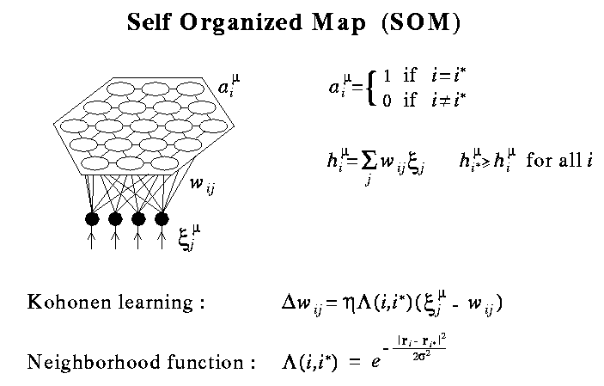
Self-Organizing Maps (Kohonen Maps)
Feature maps
Competitive networks
Neurons have locations
For each input, winner is the unit with largest output
Weights of winner and nearby units modified to resemble input pattern
Nearby inputs are thus mapped topographically
Biological relevance
Retinotopic map
Somatosensory map
Tonotopic map
Name of the Faculty: Dr. Abdul Aleem Program Name: B.Tech

Slide 16
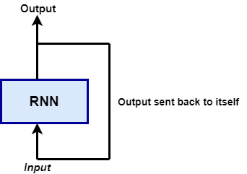
Long Short Term Memory (LSTM)
LSTM is a variant of RNN
The Recurrent Neural Network saves the output of a layer and feeds this output back to the input to better predict the outcome of the layer.
After this layer, each unit will remember some information from the previous step so that it can act as a memory cell in performing computations.
Name of the Faculty: Dr. Abdul Aleem Program Name: B.Tech

Slide 17
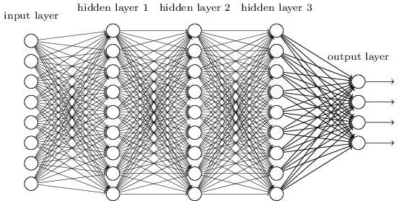
Architecture of 1980s RNN
…
Problem with this: it’s extremely deep and very hard to train
Name of the Faculty: Dr. Abdul Aleem Program Name: B.Tech

Slide 18
Problems with RNN
When dealing with a time series, it tends to forget old information. When there is a distant relationship of unknown length, we wish to have a “memory” to it.
Vanishing gradient problem.
Name of the Faculty: Dr. Abdul Aleem Program Name: B.Tech

Slide 19
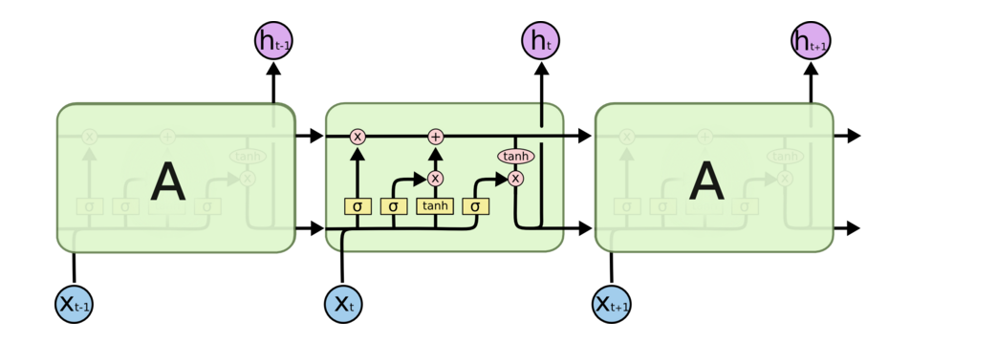
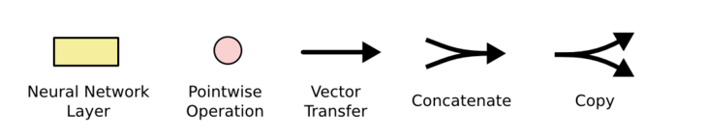
Architecture of LSTM
“Bits of memory”
Decide what to forget
Decide what to insert
Longterm-short term model
Combine with transformed x_{t}
σ: output in [0,1]
tanh: output in [-1,+1]
Name of the Faculty: Dr. Abdul Aleem Program Name: B.Tech
Notes:
Info is transferred down the chain, not just propagated
Decide when to insert imformation from input into the “backbone”

Slide 20
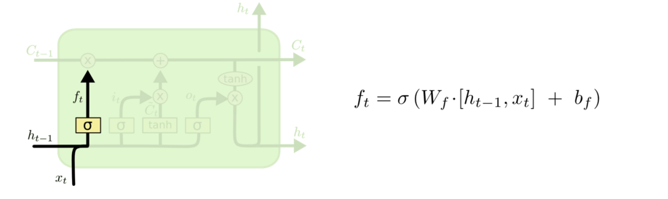
Walkthrough
What part of memory to “forget” – zero means forget this bit
Name of the Faculty: Dr. Abdul Aleem Program Name: B.Tech

Slide 21
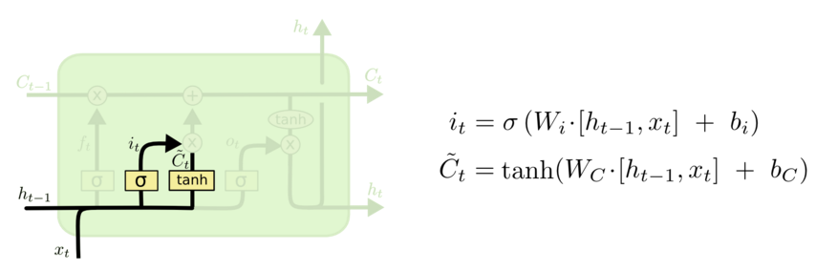
Walkthrough Cont’d …
What bits to insert into the next states
What content to store into the next state
http://colah.github.io/posts/2015-08-Understanding-LSTMs/
Name of the Faculty: Dr. Abdul Aleem Program Name: B.Tech

Slide 22
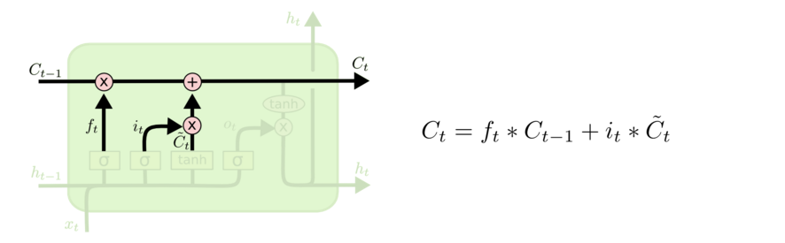
Walkthrough Cont’d …
Next memory cell content – mixture of not-forgotten part of previous cell and insertion
http://colah.github.io/posts/2015-08-Understanding-LSTMs/
Name of the Faculty: Dr. Abdul Aleem Program Name: B.Tech

Slide 23
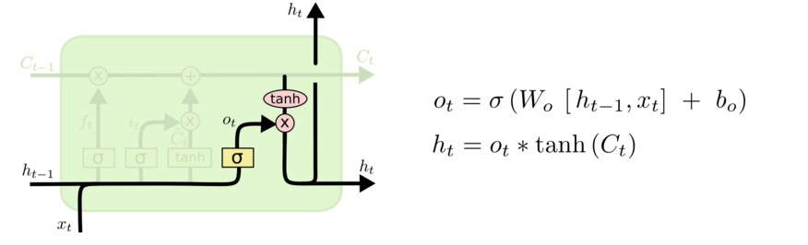
Walkthrough Cont’d …
What part of cell to output
tanh maps bits to [-1,+1] range
Name of the Faculty: Dr. Abdul Aleem Program Name: B.Tech

Slide 24
Walkthrough Cont’d …
(1)
(2)
C_{t-1}
(3)
i_{t}
o_{t}
f_{t}
Name of the Faculty: Dr. Abdul Aleem Program Name: B.Tech
Notes:
Info is transferred down the chain, not just propagated
Decide when to insert imformation from input into the “backbone”

Slide 25
Implementing LSTM
For t = 1,…,T:
(1)
(2)
(3)
Name of the Faculty: Dr. Abdul Aleem Program Name: B.Tech
Notes:
Info is transferred down the chain, not just propagated
Decide when to insert imformation from input into the “backbone”

Slide 26
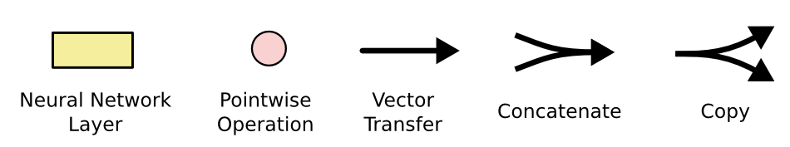
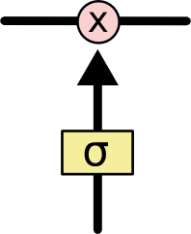
LSTM Notations
The sigmoid layer outputs numbers between 0-1 determine how much
each component should be let through. Pink X gate is point-wise multiplication.
Name of the Faculty: Dr. Abdul Aleem Program Name: B.Tech

Slide 27
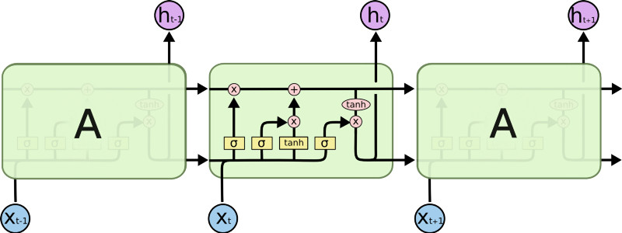
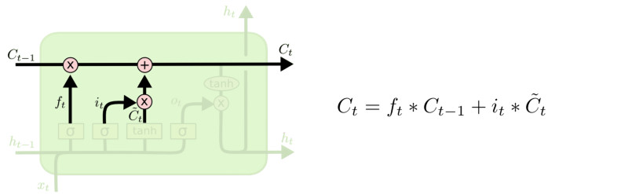
LSTM Mechanism
Output gate
Controls what
goes into output
This sigmoid gate
determines how much
information goes thru
This decides what info
Is to add to the cell state
C_{t-1}
h_{t-1}
Forget input
gate gate
The core idea is this cell state C_{t}, it is changed slowly, with only minor linear interactions. It is very easy for information to flow along it unchanged.
Why sigmoid or tanh:
Sigmoid: 0,1 gating as switch.
Vanishing gradient problem in
LSTM is handled already.
ReLU replaces tanh ok?
Name of the Faculty: Dr. Abdul Aleem Program Name: B.Tech

Slide 28
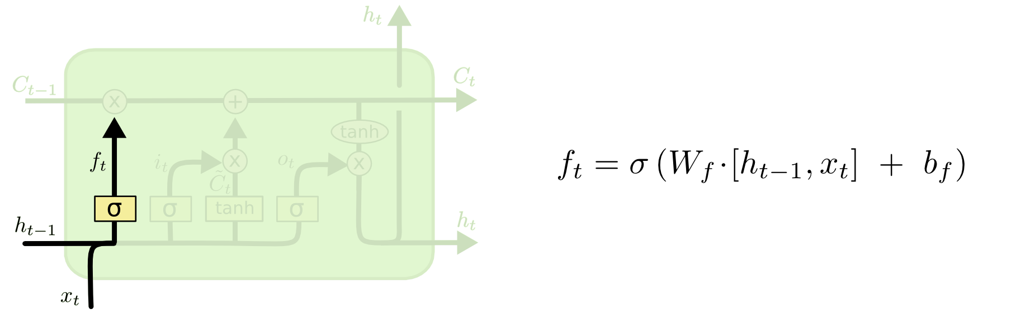
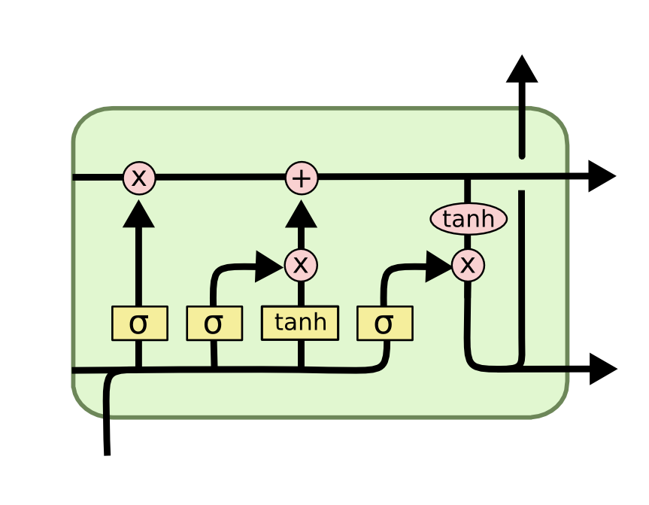
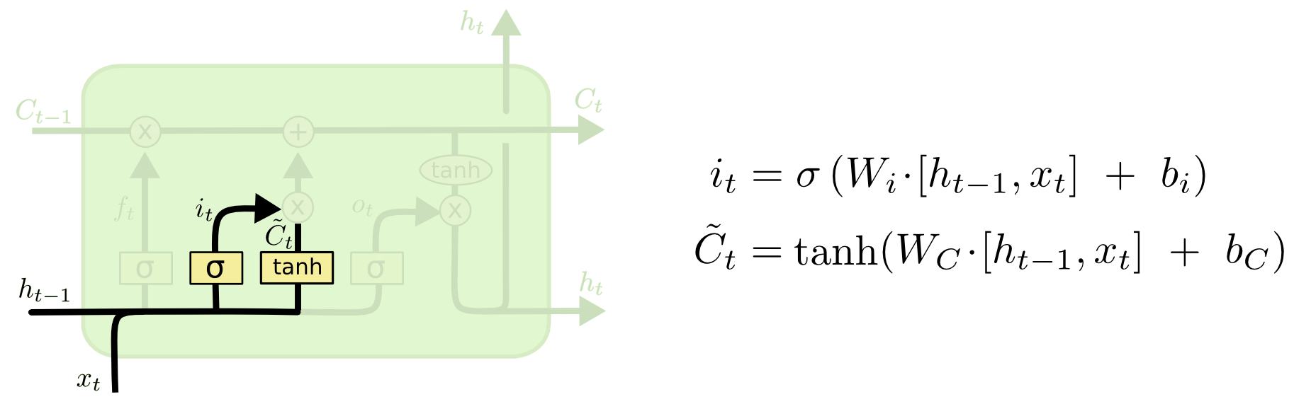
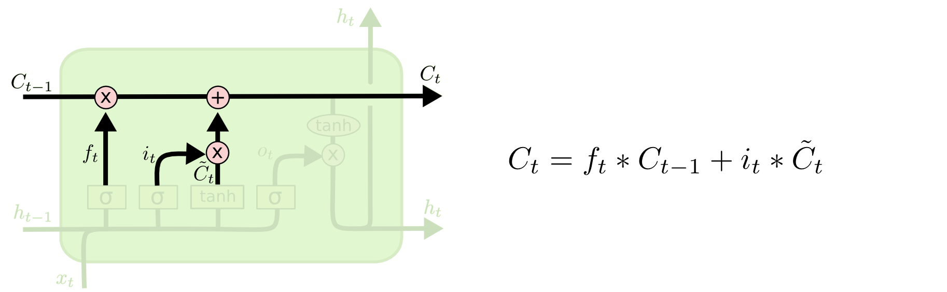
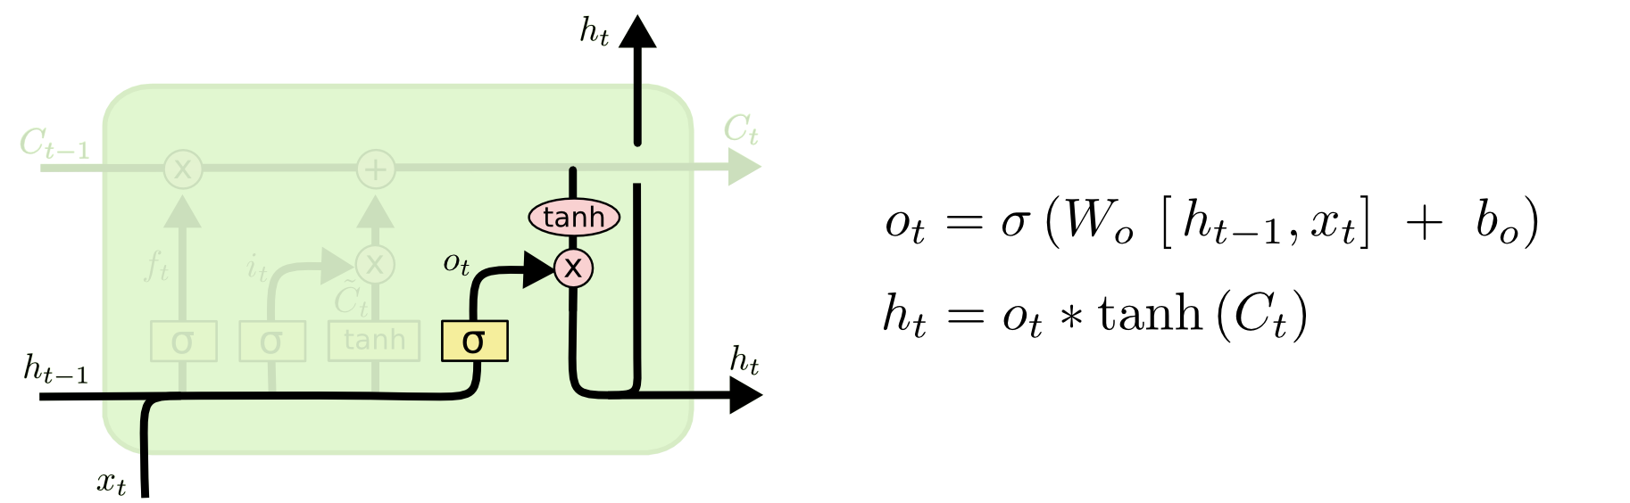
LSTM Mechanism Cont’d …
i_{t} decides what component
is to be updated.
C’_{t} provides change contents
Updating the cell state
Decide what part of the cell
state to output
Name of the Faculty: Dr. Abdul Aleem Program Name: B.Tech

Slide 29
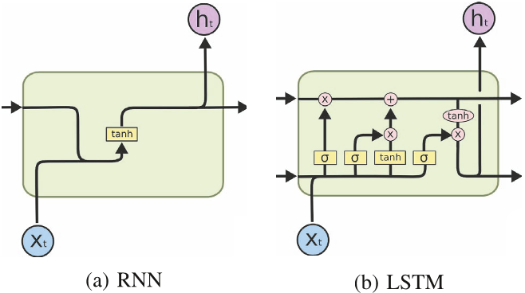
RNN vs. LSTM
Name of the Faculty: Dr. Abdul Aleem Program Name: B.Tech

Slide 30
Naïve RNN vs LSTM
y^{t}
LSTM
c^{t}
y^{t}
c^{t-1}
Naïve
RNN
h^{t}
h^{t}
h^{t-1}
h^{t-1}
x^{t}
x^{t}
c changes slowly
c^{t} is c^{t-1} added by something
h changes faster
h^{t} and h^{t-1} can be very different
Name of the Faculty: Dr. Abdul Aleem Program Name: B.Tech

Slide 31
Feed Forward vs RNN
1. Feedforward network does not have input at each step
2. Feedforward network has different parameters for each layer
x
f₁
a¹
f₂
a²
f₃
a³
f₄
y
a^{t} = f_{t}(a^{t-1}) = σ(W^{t}a^{t-1} + b^{t})
t is layer
h⁰
f
h¹
f
h²
f
h³
f
g
y⁴
x¹
x²
x³
x⁴
t is time step
a^{t}= f(a^{t-1}, x^{t}) = σ(W^{h} a^{t-1} + W^{i}x^{t} + b^{i})
We will turn the recurrent network 90 degrees
Name of the Faculty: Dr. Abdul Aleem Program Name: B.Tech

Slide 32
Gated Recurrent Unit (GRU)
Gated Recurrent Unit (GRU) is a type of recurrent neural network (RNN) that was introduced by Cho et al. in 2014 as a simpler alternative to Long Short-Term Memory (LSTM) networks.
Like LSTM, GRU can process sequential data such as text, speech, and time-series data.
The basic idea behind GRU is to use gating mechanisms to selectively update the hidden state of the network at each time step.
The gating mechanisms are used to control the flow of information in and out of the network.
Name of the Faculty: Dr. Abdul Aleem Program Name: B.Tech

Slide 33
Gated Recurrent Unit (GRU)
The GRU has two gating mechanisms, called the reset gate and the update gate.
The reset gate determines how much of the previous hidden state should be forgotten, while the update gate determines how much of the new input should be used to update the hidden state.
The output of the GRU is calculated based on the updated hidden state.
Name of the Faculty: Dr. Abdul Aleem Program Name: B.Tech

Slide 34
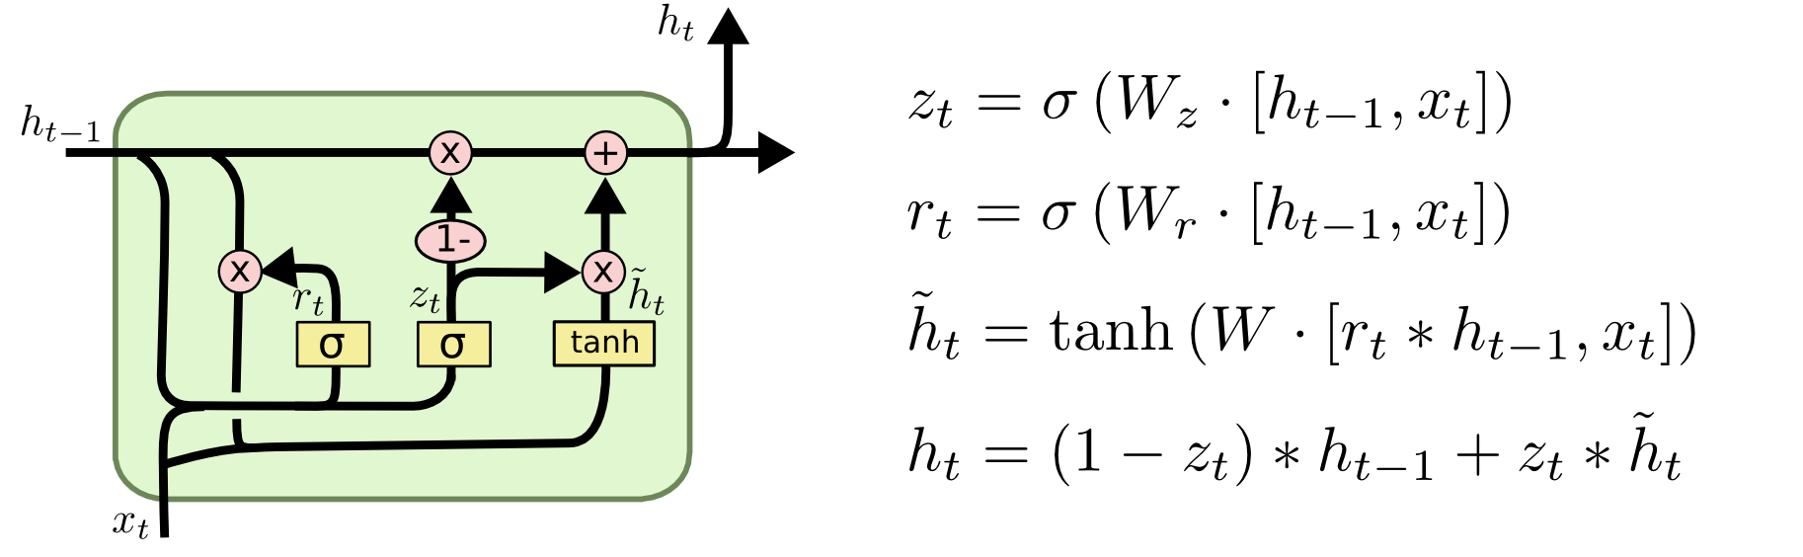
GRU Architecture
LSTM
reset gate
Update gate
X,*: element-wise multiply
It combines the forget and input into a single update gate.
It also merges the cell state and hidden state. This is simpler
than LSTM. There are many other variants too.
Name of the Faculty: Dr. Abdul Aleem Program Name: B.Tech

Slide 35
Bi-directional RNNs
Combine an RNN that moves forward through time from the start of the sequence and another RNN that moves backward through time beginning from the end of the sequence
A bidirectional RNN consists of two RNNs which are stacked on the top of each other.
The one that processes the input in its original order and the one that processes the reversed input sequence.
The output is then computed based on the hidden state of both RNNs.
Name of the Faculty: Dr. Abdul Aleem Program Name: B.Tech

Slide 36
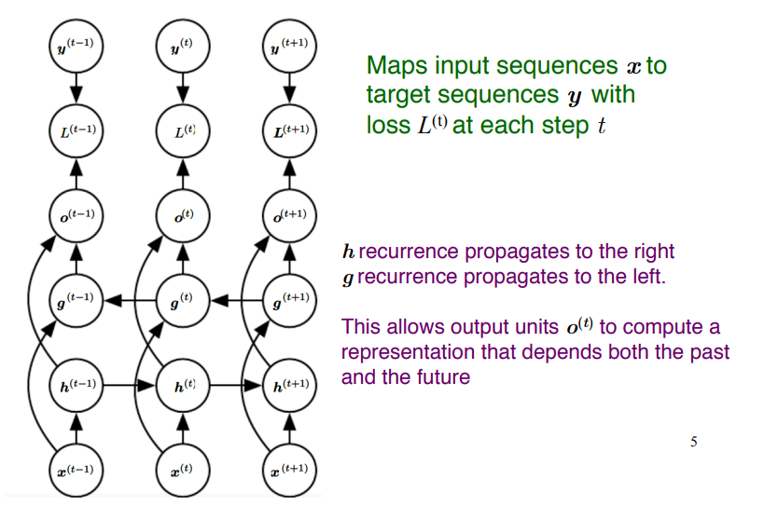
Bi-directional RNN/LSTMs
Name of the Faculty: Dr. Abdul Aleem Program Name: B.Tech

Slide 37


